Slide 1
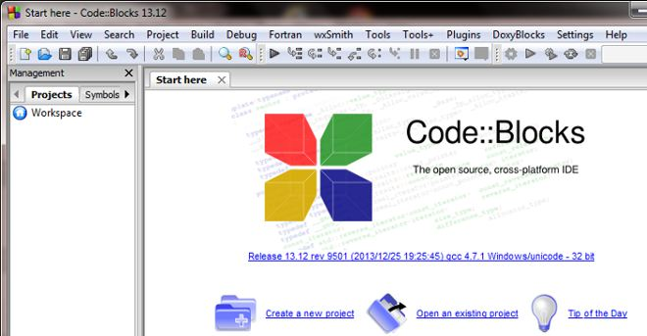
How to use Code::Blocks for c++
Start Code:Blocks, you will get:

Slide 2
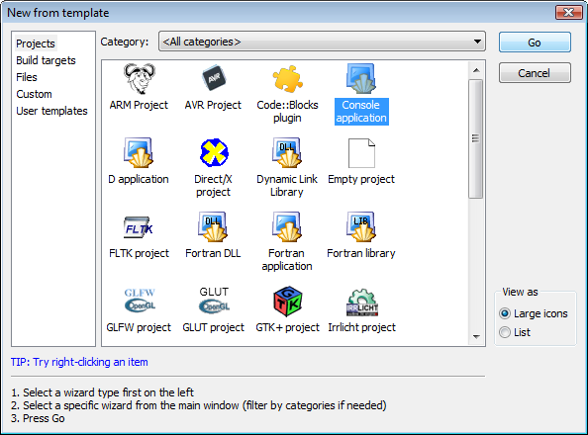
To start a new project, launch the Project Wizard through File->New->Project

Slide 3
Select Console application, as this is the most common for general purposes, an click Go to get:

Slide 4
Click Next to get (make sure c++ is highlighted)

Slide 5
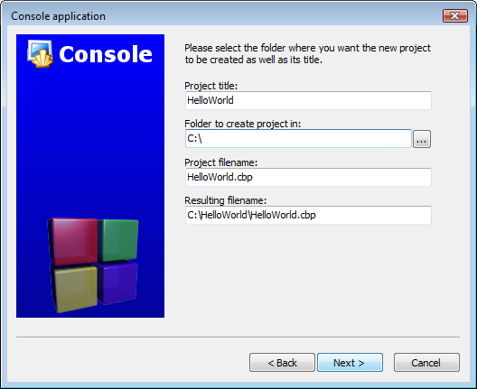
Give the project a name and type or select a destination folder. (Code::Blocks will generate the remaining entries from these two.)

Slide 6
Keep everything as default (this is where the compiler, debug, and release configuration is set)

Slide 7
Click Finish and the project will be generated.
Under Projects tab of the Management pane on the left
Expand the folders
Double click on the source file main.cpp to open it in the editor.

Slide 8
Press Ctrl-F9, Build->Build, to compile the project.

Slide 9
Press Ctrl-F10, Build->Run, to run your program.

